Slide 1
Master Budget
Sales
Forecast
Sales
Budget
Ending
Finished Goods
Budget
Selling and
Administrative
Budget
Production
Budget
Direct
Materials
Budget
Direct
Labor
Budget
Manufacturing
Overhead
Budget
Cash
Budget
Capital Budget
Budgeted Financial Statements
Notes:
The master budget consists of a number of separate but interdependent budgets. We have developed this schematic of the budgeting process to illustrate the interdependency of the various individual budgets.

Slide 2
The Basic Framework of Budgeting
A budget is a detailed quantitative plan for acquiring and using financial and other resources over a specified forthcoming time period.
The act of preparing a budget is called budgeting.
The use of budgets to control an organization’s activity is known as budgetary control.
Notes:
Budgeting helps managers make decisions about resources needed and financial results expected for the coming period. Budgets are used to control activities of an organization because they set out a plan for the entire organization.

Slide 3
Planning and Control
Planning –
involves developing objectives and preparing various budgets to achieve these objectives.
Control –
involves the steps taken by management that attempt to ensure the objectives are attained.
Notes:
To be effective, a good budgeting system must provide for both planning and control. Good planning without effective control is time wasted.

Slide 4
Advantages of Budgeting
Define goal
and objectives
Communicate
plans
Think about and
plan for the future
Advantages
Coordinate
activities
Means of allocating
resources
Uncover potential
bottlenecks
Notes:
Budgets communicate management’s plans throughout the organization. Budgets force managers to think about and plan for the future. While our focus in this chapter is on preparing operating budgets for a one-year time frame, longer term budgets also can be very helpful to organizations from a planning standpoint.

Slide 5
Responsibility Accounting
Managers should be held responsible for those items — and only those items — that
the manager can actually control
to a significant extent.
Notes:
A responsibility accounting system enables management to react quickly to deviations from their plans and to learn from feedback obtained by comparing budgeted goals to actual results.

Slide 6
Choosing the Budget Period
Operating Budget
2013
2014
2015
2016
The annual operating budget
may be divided into quarterly
or monthly budgets.
A continuous budget is a 12-
month budget that rolls forward
one month (or quarter) as the
current month (or quarter) is
completed.
Notes:
Operating budgets ordinarily cover a one-year period corresponding to a company’s fiscal year. Many companies divide their annual budget into four quarters. In this chapter we focus on one-year operating budgets. A continuous or perpetual budget is a twelve-month budget that rolls forward one month (or quarter) as the current month (or quarter) is completed. This approach keeps managers focused on the future at least one year ahead.

Slide 7

Human Factors in Budgeting
The success of budgeting depends upon three important factors:
Top management must be enthusiastic and committed to the budget process.
Top management must not use the budget to pressure employees or blame them when something goes wrong.
Highly achievable budget targets are usually preferred when managers are rewarded based on meeting budget targets.
Notes:
Without the clear and unconditional support of top management, any budget process is bound to fail. Employees must believe that the budgets prepared are meaningful to the decision process of managers. While budgets help managers control activities, the most successful use of budgeting is to reward behavior that management is trying to encourage.

Slide 8
Master Budget
Sales
Forecast
Sales
Budget
Ending
Finished Goods
Budget
Selling and
Administrative
Budget
Production
Budget
Direct
Materials
Budget
Direct
Labor
Budget
Manufacturing
Overhead
Budget
Cash
Budget
Capital Budget
Budgeted Financial Statements
Notes:
The master budget consists of a number of separate but interdependent budgets. We have developed this schematic of the budgeting process to illustrate the interdependency of the various individual budgets.

Slide 9

Sales
Forecast
Financial Budget
Operating Budget
Sales
Forecast
Sales
Budget
Ending
Finished Goods
Budget
Selling and
Administrative
Budget
Production
Budget
Direct
Materials
Budget
Direct
Labor
Budget
Manufacturing
Overhead
Budget
Cash
Budget
Capital Budget
Capitol Budget
Budgeted Financial Statements
Notes:
The master budget consists of a number of separate but interdependent budgets. We have developed this schematic of the budgeting process to illustrate the interdependency of the various individual budgets.

Slide 10
Budgeting Example
Royal Company is preparing budgets for the quarter ending June 30.
Budgeted sales for the next five months are:
  April 20,000 units
  May 50,000 units
  June 30,000 units
  July 25,000 units
  August 15,000 units.
The selling price is $10 per unit.
Notes:
The marketing department has developed the following information that will be used to prepare a budget for the quarter ending June 30th.

Slide 11
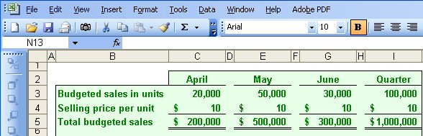
The Sales Budget
The individual months of April, May, and June are summed to obtain the total projected sales in units and dollars for the quarter ended June 30th
Notes:
Royal sells only one product and that product has a selling price of ten dollars per unit. To calculate the total sales in dollars for any period we multiply the projected sales in units times the unit selling price. As you can see, for the quarter ended June 30th, Royal forecasts unit sales of one hundred thousand and total sales revenue of one million dollars.
Once we complete the sales budget, we can move on to the expected cash collections from sales.

Slide 12
Expected Cash Collections
All sales are on account.
Royal’s collection pattern is:
  70% collected in the month of sale,
  25% collected in the month following sale,
  5% uncollectible.
The March 31 accounts receivable balance of $30,000 will be collected in full.
Notes:
All sales at Royal are made on account. The company collects seventy percent of the sales revenue in the month of sale, twenty five percent in the following month, and estimates that five percent of all credit sales will prove uncollectible.
At the start of the quarter Royal had thirty thousand dollars in accounts receivable that were deemed to be fully collectible.
Let’s prepare the budget of expected cash collections on sales.

Slide 13
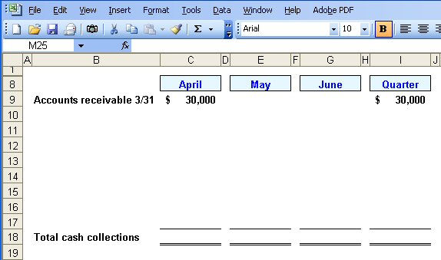
Expected Cash Collections
Notes:
We expect to collect all thirty thousand dollars in accounts receivable during the month of April.

Slide 14
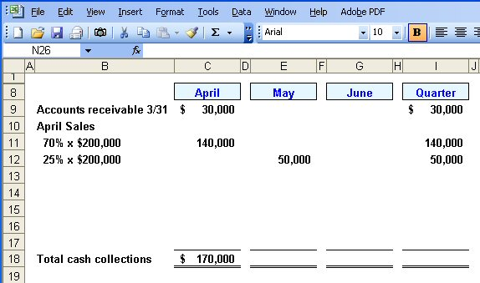
Expected Cash Collections
From the Sales Budget for April.
Notes:
In addition to the thirty thousand dollars, we expect to collect seventy percent of the project sales for April of two hundred thousand dollars. So we will collect another one hundred forty thousand dollars in April. Notice that twenty-five percent of April projected sales will be collected in May. Fifty thousand dollars of April sales will be collected in May.

Slide 15
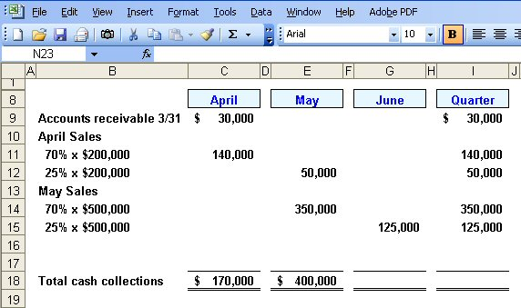
Expected Cash Collections
From the Sales Budget for May.
Notes:
We follow a similar procedure for the month of May. Seventy percent of May projected sales will be collected in May. This amounts to three hundred fifty thousand dollars.
Can you complete the final month of June to get the total expected cash collections for the quarter?

Slide 16
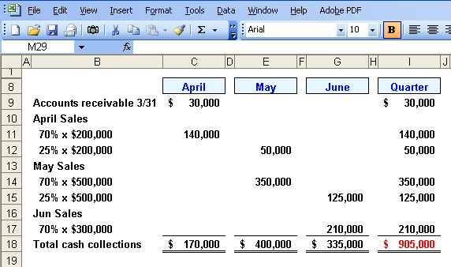
Expected Cash Collections
Notes:
We expect to collect two hundred ten thousand dollars from June sales in the month of June. When we carry all the cash collections to the Quarter column, you can see that we expect to collect nine hundred five thousand dollars for the quarter.
Now let’s turn our attention to the production budget.

Slide 17

The Production Budget
Sales
Budget
and
Expected
Cash
Collections
Production
Budget
Completed
Production must be adequate to meet budgeted
sales and provide for sufficient ending inventory.
Notes:
After we have budgeted our sales and expected cash collection, we must make sure the our production is adequate to meet the forecasted sales and provide a sufficient ending inventory. We need inventory on hand at the end of the period to minimize the likelihood of an inventory stock-out.

Slide 18
The Production Budget
The management at Royal Company wants ending inventory to be equal to 20% of the following month’s budgeted sales in units.
On March 31, 4,000 units were on hand.
Notes:
The management at Royal wants to minimize the probability of a stock out of inventory items. A policy has been implemented that requires the company to maintain ending inventory of twenty percent of the following month’s budgeted sales. At the beginning of the quarter, Royal had four thousand units in inventory.
Let’s get started on the production budget.

Slide 19
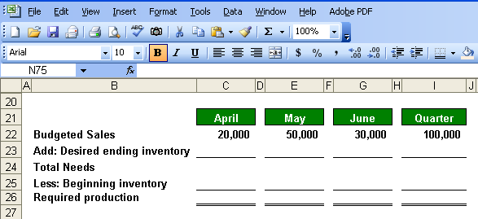
The Production Budget
Notes:
We start our production budget with the budgeted sales in units.

Slide 20
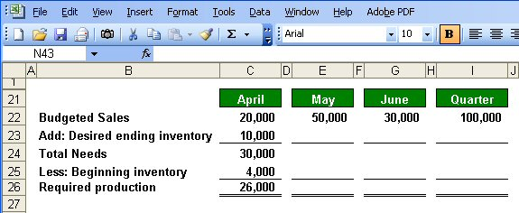
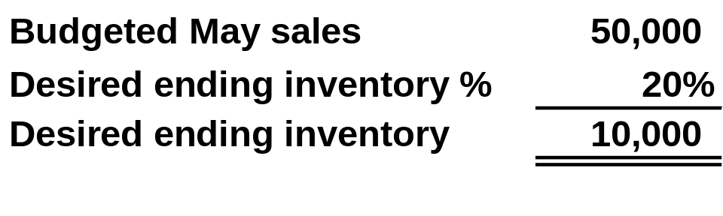
The Production Budget
March 31
ending inventory
Notes:
Part I
Here is the completed production budget for April. Let’s see how we put the budget together. We start the monthly budget with projected sales in units for the month. These numbers come from our sales budget.
Part II
The desired ending inventory is recognition of management’s policy against stock-out of inventory. We determine the number of units by multiplying May’s projected unit sales times the twenty percent established by management as part of its policy. We add the desired ending inventory in units to the projected sales to get our total unit needs for the month.
Part III
Finally, we subtract the current periods inventory. In our case, Royal had four thousand units in inventory at the end of March. We have now calculated our required production for the month of April.

Slide 21
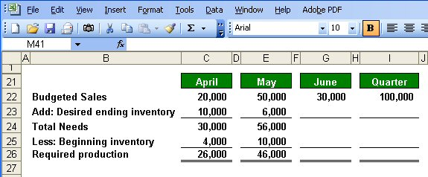
The Production Budget
Notes:
Notice that the desired ending inventory for April becomes the beginning inventory for May.
Now let’s complete the schedule.

Slide 22
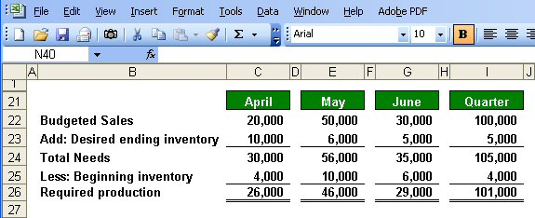
The Production Budget
Assumed ending inventory.
Notes:
Part I
We have assumed an ending inventory on June 30th of five thousand units.
If you refer back to the sales data, July sales units are estimated to be twenty-five thousand, and twenty percent of twenty-five thousand equals five thousand units.
Part II
The ending inventory at June 30th becomes the ending inventory for the quarter.
Part III
The beginning inventory comes from the March 31st inventory of four thousand units. Be careful that you don’t just carry the six thousand units at the beginning of June to the beginning inventory for the quarter column. It is a common mistake.
For the quarter we will need to produce one hundred one thousand units to meet our sales and inventory goals. Now that we know our required production, let’s look at the direct materials budget.

Slide 23
The Direct Materials Budget
At Royal Company, five pounds of material are required per unit of product.
Management wants materials on hand at the end of each month equal to 10% of the following month’s production.
On March 31, 13,000 pounds of material are on hand. Material cost is $0.40 per pound.
Let’s prepare the direct materials budget.
Notes:
Each good unit of output requires five pounds of direct material. Management does not want to run out of direct materials, so a policy has been established that materials on hand at the end of each month must be equal to ten percent of the following month’s production. At the beginning of the month Royal has thirteen thousand pounds of direct material on hand. Each pound of direct material costs forty cents.
Let’s complete the direct materials budget.

Slide 24
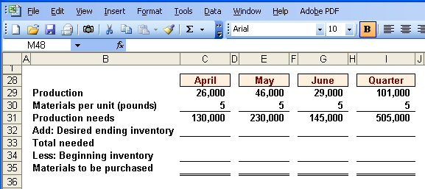
The Direct Materials Budget
From production budget
Notes:
We begin with our required production from the production budget just completed. We multiply the required unit production by the number of pounds of direct materials needed. In our case that is five pounds per unit. For April, we will need one hundred thirty thousand pounds of direct materials.

Slide 25
The Direct Materials Budget
Notes:
We begin with our required production from the production budget just completed. We multiply the required unit production by the number of pounds of direct materials needed. In our case that is five pounds per unit. For April, we will need one hundred thirty thousand pounds of direct materials.

Slide 26
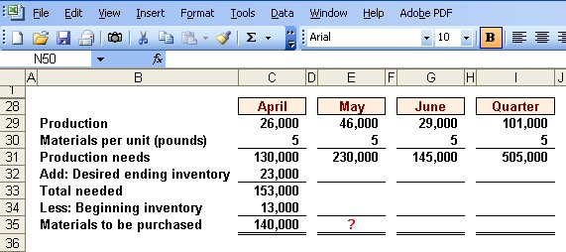
The Direct Materials Budget
March 31 inventory
10% of following months production needs.
Calculate the materials to
by purchased in May.
Notes:
Part I
To our production needs we must add the number of pounds necessary to meet management’s policy regarding minimum inventory levels.
Part II
The ending inventory for April is equal to ten percent of May’s production needs, or twenty-three thousand pounds. The total number of pounds needed in April is one hundred fifty-three thousand pounds.
Part III
Finally, we subtract our materials on hand to arrive at the number of pounds of material that must be purchased. During April, Royal must purchase one hundred forty thousand pounds of direct materials.
Why don’t you calculate the materials to be purchased in May?

Slide 27
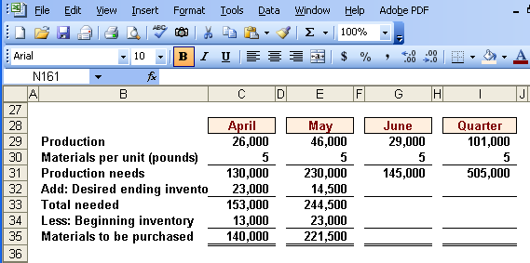
The Direct Materials Budget
Notes:
Recall that the ending inventory in one month becomes the beginning inventory in the next month. You can see that two hundred twenty-one thousand five hundred pounds of material must be purchased in May. Now, let’s move on an complete the schedule.

Slide 28
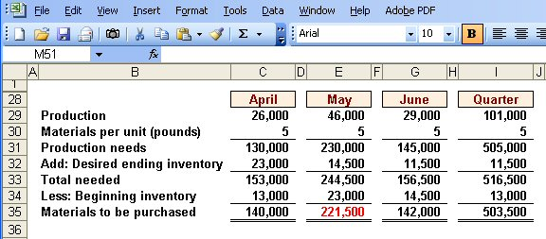
The Direct Materials Budget
Assumed ending inventory
Notes:
Here is the complete schedule for May and June. Once again, you can see that the ending inventory in May becomes the beginning inventory in June. Notice that we assumed an ending inventory of eleven thousand five hundred pounds. For the quarter we will need to purchase five hundred three thousand five hundred pounds of direct materials.
Did you remember to bring the beginning inventory from April to the quarter column?

Slide 29
Expected Cash Disbursement for Materials
Royal pays $0.40 per pound for its materials.
One-half of a month’s purchases is paid for in the month of purchase; the other half is paid in the following month.
The March 31 accounts payable balance is $12,000.
Notes:
Recall that Royal pays forty cents per pound of direct materials. It pays for its purchases one-half in the month of the purchase and one-half in the following month. At the beginning of the quarter, Royal owed creditors twelve thousand dollars for purchases of direct materials.
Let’s begin the expected cash disbursement for direct materials schedule.

Slide 30
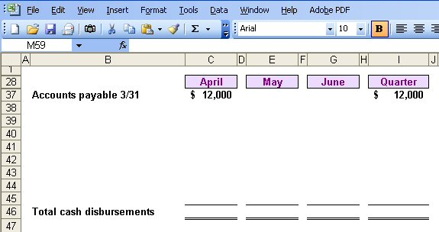
Expected Cash Disbursement for Materials
Notes:
We will pay the twelve thousand dollars from March in the month of April.

Slide 31
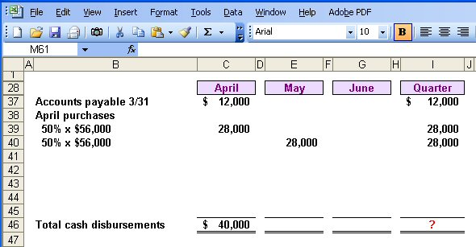
Expected Cash Disbursement for Materials
140,000 lbs. × $.40/lb. = $56,000
Notes:
In addition to the twelve thousand dollars, Royal will pay one-half of the cost of purchasing one hundred forty thousand pounds of direct material at forty cents per pound (fifty-six thousand dollars).
Please complete the schedule for the quarter and see how your work is progressing.

Slide 32
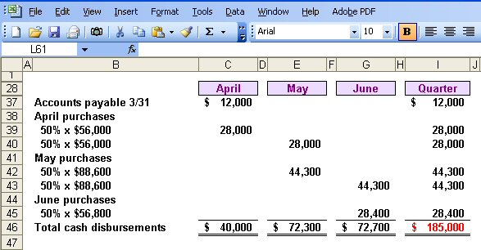
Expected Cash Disbursement for Materials
Notes:
The computations are very similar to those we made for the expected cash collections on sales.
Now let’s move to the direct labor budget.

Slide 33
The Direct Labor Budget
At Royal, each unit of product requires 0.05 hours (3 minutes) of direct labor.
The Company has a “no layoff” policy so all employees will be paid for 40 hours of work each week.
In exchange for the “no layoff” policy, workers agree to a wage rate of $10 per hour regardless of the hours worked (No overtime pay).
For the next three months, the direct labor workforce will be paid for a minimum of 1,500 hours per month.
Notes:
Carefully review the information on the screen. A unique aspect of direct labor at Royal is the no overtime policy. The company agrees to no layoffs of employees if work is slow, but in return, pays its employees straight time at ten dollars per hour for all hours worked. With the current work force, Royal will have to pay for a minimum of one thousand five hundred hours of direct labor regardless of the work available.
Let’s prepare this budget.

Slide 34
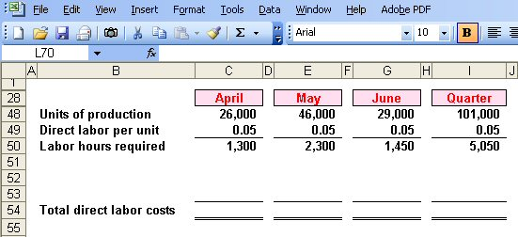
The Direct Labor Budget
From production budget
Notes:
Once again we start with our production budget computations. We multiply the number of units to produce by the time required to produce one unit and see that we will require one thousand three hundred direct labor hours in April, two thousand three hundred in May and one thousand four hundred fifty hours in June.

Slide 35
The Direct Labor Budget
Notes:
Once again we start with our production budget computations. We multiply the number of units to produce by the time required to produce one unit and see that we will require one thousand three hundred direct labor hours in April, two thousand three hundred in May and one thousand four hundred fifty hours in June.

Slide 36
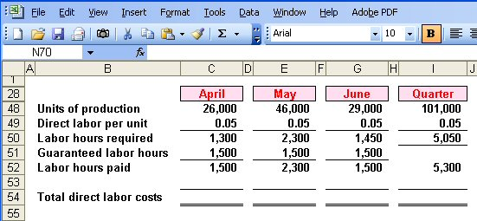
The Direct Labor Budget
Greater of labor hours required
or labor hours guaranteed.
Notes:
Because of the no layoff policy, Royal is committed to paying for a minimum of fifteen hundred hours per month. The number of hours paid will be the greater of the direct labor hours required, or fifteen hundred hours.
In April, Royal will pay for fifteen hundred direct labor hours when there is only work for thirteen hundred hours. In May, Royal will pay for twenty-three hundred direct labor hours. and will pay for fifteen hundred hours in June. For the quarter, the company will pay for fifty-three hundred direct labor hours.

Slide 37
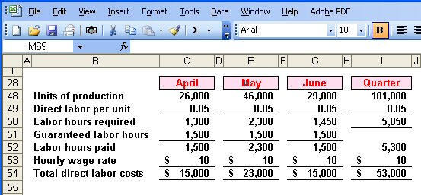
The Direct Labor Budget
Notes:
With a straight time rate of ten dollars per hour, Royal will pay fifteen thousand dollars for direct labor in April, twenty-three thousand in May, and fifteen thousand in June, for a total of fifty-three thousand dollars.

Slide 38
Manufacturing Overhead Budget
At Royal manufacturing overhead is applied to units of product on the basis of direct labor hours.
The variable manufacturing overhead rate is $20 per direct labor hour.
Fixed manufacturing overhead is $50,000 per month and includes $20,000 of noncash costs (primarily depreciation of plant assets).
Notes:
Royal applies overhead on the basis of direct labor hours. The variable manufacturing overhead rate is twenty dollars per direct labor hour. The fixed overhead is fifty thousand dollars per month, of which twenty thousand dollars is noncash costs, primarily depreciation on the factory assets.

Slide 39
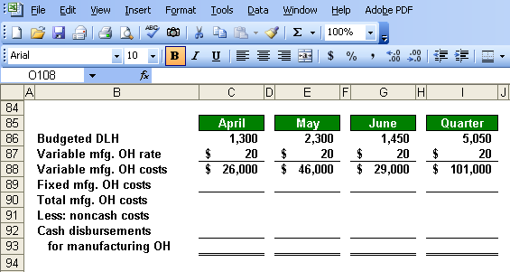
Manufacturing Overhead Budget
Direct Labor Budget
Notes:
We begin by multiplying our variable manufacturing overhead rate of twenty dollars times the number of direct labor hours used in the month. For April, we expect to apply twenty-six thousand dollars of variable overhead.

Slide 40
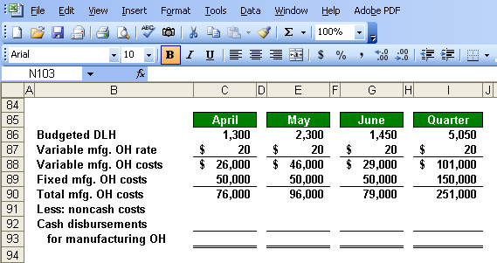
Manufacturing Overhead Budget
Total mfg. OH for quarter $251,000
Total labor hours required 5,050
= $49.70 per hour*
*rounded
Notes:
Part I
Next, we add the fixed overhead to our calculation of the variable overhead rate. We estimate total overhead of seventy-six thousand dollars in April and for the quarter, we expect a total of two hundred fifty-one thousand dollars.
Part II
If we divide the manufacturing overhead of two hundred fifty-one thousand dollars by the total labor hours required during the quarter, we get a predetermined overhead rate of forty-nine dollars and seventy cents (rounded). Remember, when determining the overhead rate we use the total labor hours required rather than the hours paid.

Slide 41
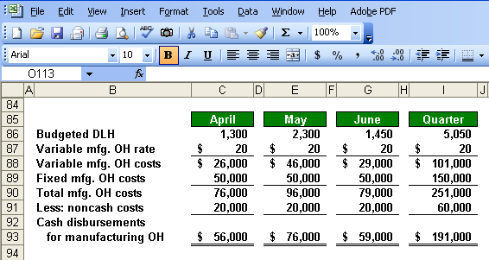
Manufacturing Overhead Budget
Depreciation is a noncash charge.
Notes:
If we subtract the noncash overhead costs from the total manufacturing overhead costs, we get the cash paid for overhead costs. We will use this cash overhead amount in our cash budget.

Slide 42
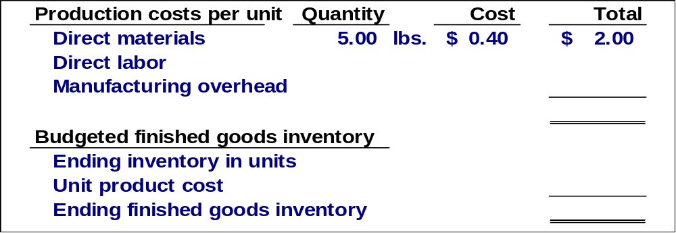
Ending Finished Goods Inventory Budget
Direct materials
budget and information
Notes:
For the direct materials portion of our product unit cost we know that each unit requires five pounds of direct material at forty cents per pound, for a total of two dollars per unit.

Slide 43
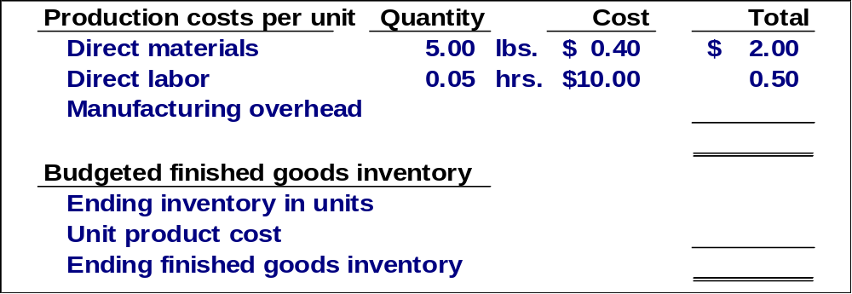
Ending Finished Goods Inventory Budget
Direct labor budget
Notes:
It takes point zero five hours to produce one unit and the pay rate is ten dollars per hour. We have a direct labor cost per unit of fifty cents.

Slide 44
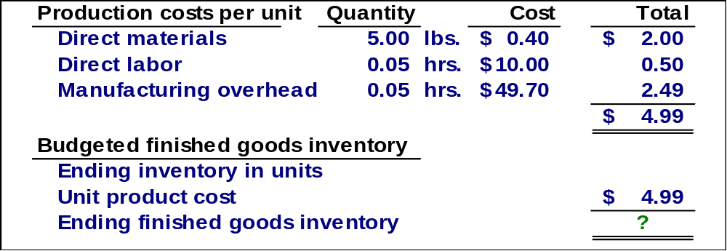
Ending Finished Goods Inventory Budget
Total mfg. OH for quarter $251,000
Total labor hours required 5,050
= $49.70 per hour*
Notes:
We apply overhead on the basis of direct labor hours, so we multiply point zero five hours times the predetermined rate of forty-nine dollars and seventy cents, and get overhead cost per unit of two dollars and forty-nine cents. Our total unit cost is four dollars and ninety-nine cents.
Calculate the cost of our ending finished goods inventory.

Slide 45
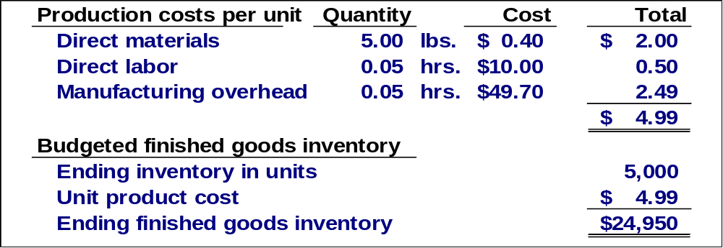
Ending Finished Goods Inventory Budget
Production Budget
Notes:
We estimate there will be five thousand units in ending inventory and at a per unit cost of four dollars and ninety-nine cents, we have a total cost of twenty-four thousand nine hundred fifty dollars. The finished goods inventory will appear on our budgeted balance sheet.

Slide 46
Selling and Administrative Expense Budget
At Royal, the selling and administrative expenses budget is divided into variable and fixed components.
The variable selling and administrative expenses are $0.50 per unit sold.
Fixed selling and administrative expenses are $70,000 per month.
The fixed selling and administrative expenses include $10,000 in costs – primarily depreciation – that are not cash outflows of the current month.
Notes:
Royal has a variable and fixed component to its selling and administrative expenses. The company estimates variable selling and administrative expenses at fifty cents per unit sold. Fixed selling and administrative expenses are estimated at seventy thousand dollars per month. Of this amount, ten thousand are noncash expenses, primarily depreciation.
The selling and administrative expense budget will be prepared in a manner similar to our overhead budget.

Slide 47
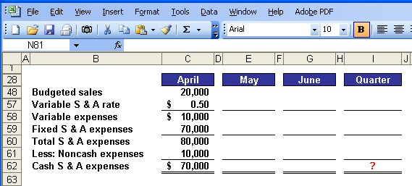
Selling and Administrative Expense Budget
Notes:
Variable selling and administrative expenses are based on units sold. In April we expect to sell twenty thousand units and apply the variable rate of fifty cents per unit.
To our variable expenses we add our estimated seventy thousand fixed selling and administrative expenses to get total selling and administrative expenses of eighty thousand dollars.
Finally, we subtract the noncash portion of the fixed expenses to arrive at cash selling and administrative expenses for April of seventy thousand dollars.
Take a few minutes to complete the schedule and see what kind of progress you are making.

Slide 48
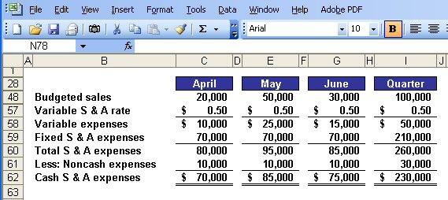
Selling and Administrative Expense Budget
Notes:
You can see how similar this schedule is to the manufacturing overhead schedule.

Slide 49
Format of the Cash Budget
The cash budget is divided into four sections:
Cash receipts listing all cash inflows excluding borrowing
Cash disbursements listing all payments excluding repayments of principal and interest
Cash excess or deficiency
The financing section listing all borrowings, repayments and interest
Notes:
The preparation of the cash budget can be quite complex. We have to pay close attention to details from our other budgets if we are to be successful in preparing the cash budget.
On your screen, we listed the four major sections of the cash budget. As we prepare the budget, you will clearly see these four sections.

Slide 50
The Cash Budget
Royal:
  Maintains a 16% open line of credit for $75,000
  Maintains a minimum cash balance of $30,000
  Borrows on the first day of the month and repays loans on the last day of the month
  Pays a cash dividend of $49,000 in April
  Purchases $143,700 of equipment in May and $48,300 in June paid in cash
  Has an April 1 cash balance of $40,000
Notes:
It would be a good idea to jot down this additional information or merely print the screen. We will need all of it to prepare the cash budget.

Slide 51
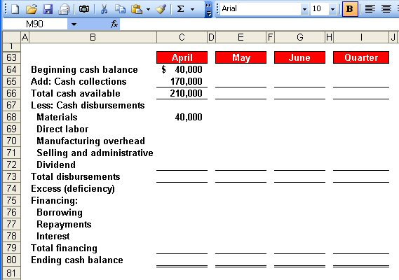
The Cash Budget
Schedule of Expected
Cash Collections
Notes:
We began April with forty thousand dollars in cash. To this amount we add our expected cash collections from sales for the month of April of one hundred seventy thousand dollars. We complete the first section by calculating the total cash available of two hundred ten thousand dollars.
Now, let’s continue with the budget preparation.

Slide 52
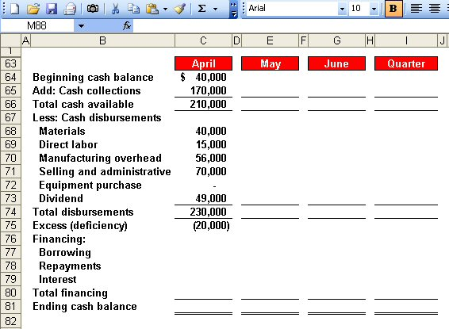
The Cash Budget
Schedule of Expected
Cash Disbursements
Direct Labor
Budget
Manufacturing
Overhead Budget
Selling and Administrative
Expense Budget
Notes:
During April we expect to pay forty thousand dollars for raw materials, fifteen thousand dollars in direct labor, fifty-six thousand in cash manufacturing overhead, and seventy thousand dollars for selling and administrative expense.. This is not the total manufacturing overhead because we have excluded noncash depreciation costs. During April, the Board of Directors paid a cash dividend of forty nine thousand dollars.
We have not completed the second major section of the cash budget, the cash disbursements.

Slide 53
The Cash Budget
Because Royal maintains
a cash balance of $30,000,
the company must borrow $50,000 on it line-of-credit.
Notes:
The third section of the cash budget is to determine any cash excess or deficiency. In the month of April will expect to have a cash deficiency of twenty thousand dollars. Since Royal has a policy that the company will always maintain an ending cash balance of thirty thousand dollars, it will have to borrow fifty thousand dollars against its line-of-credit in April.

Slide 54
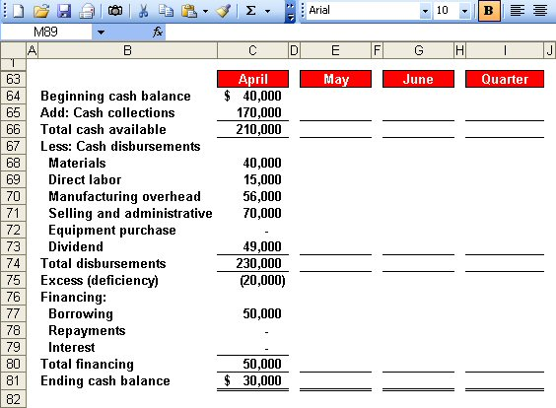
The Cash Budget
Ending cash balance for April
is the beginning May balance.
Notes:
After Royal borrows on its line-of-credit, it will have an ending cash balance of thirty thousand dollars. The ending cash balance for April becomes the beginning cash balance for May.
Let’s complete the cash budget for the month of May.

Slide 55
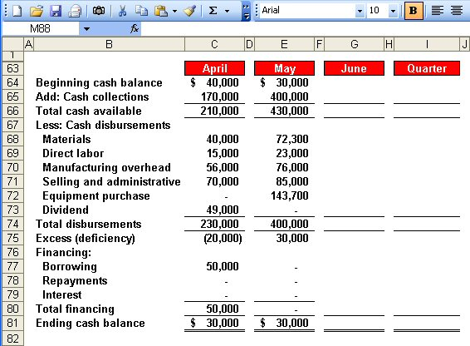
The Cash Budget
Notes:
Refer back to our previous budgets to get the cash collection, cash disbursements for direct materials, direct labor, manufacturing overhead, and selling and administrative expenses. The new item in May is that the company plans to purchase one hundred forty-three thousand seven hundred dollars worth of equipment.
For May the company will have a cash excess of thirty thousand dollars, but will not be able to repay the monies borrowed on the line-of-credit or the accrued interest.
It’s your turn to calculate the cash excess or deficiency for the month of June.

Slide 56
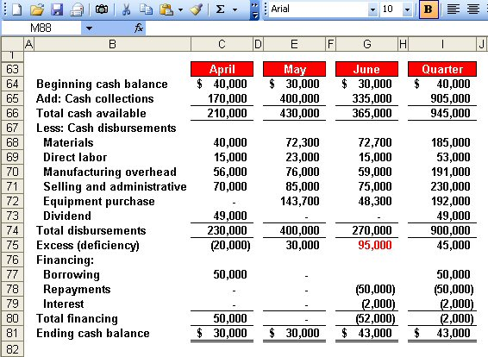
The Cash Budget
$50,000 × 16% × 3/12 = $2,000
Borrowings on April 1 and
repayment on June 30.
Notes:
You can see the cash excess of ninety-five thousand dollars.
At the end of June, Royal will have sufficient cash to repay the fifty thousand dollars borrowed in April plus the interest on the loan. The total interest is two thousand dollars as demonstrated in the computation of interest box on the left side of your screen.
Royal will end the quarter with forty-three thousand dollars cash on hand. This cash balance will appear on our budgeted balance sheet.

Slide 57
The Budgeted Income Statement
Cash
Budget
Budgeted
Income
Statement
Completed
After we complete the cash budget, we can prepare the budgeted income statement for Royal.
Notes:
We are now ready to move from the preparation of individual budgets to compiling our budgeted financial statements. Let’s begin with the budgeted income statement.

Slide 58
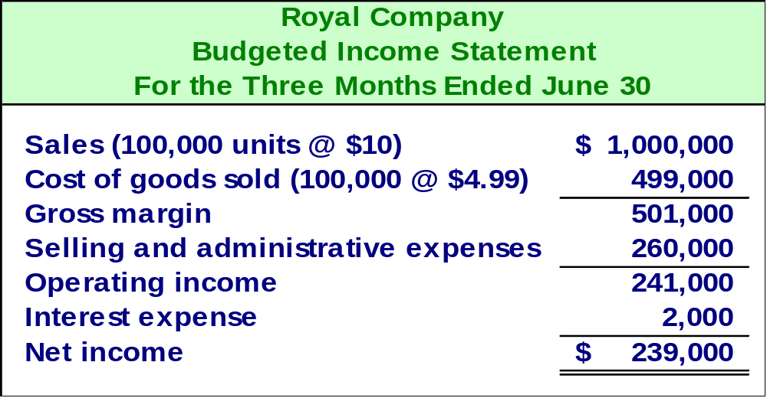
The Budgeted Income Statement
Sales Budget
Ending Finished
Goods Inventory
Selling and
Administrative
Expense Budget
Cash Budget
Notes:
Recall that Royal planned to sell one hundred thousand units during the quarter at ten dollars per unit.
We determined the unit cost at four dollars and ninety-nine cents, so cost of goods sold will be four hundred ninety-nine thousand dollars.
Our selling and administrative expenses, including depreciation, total two hundred sixty thousand dollars and we incurred two thousand dollars of interest expense during the quarter.
Our budgeted net income for the quarter is two hundred thirty-nine thousand dollars.
With the income statement complete, we can move on to the budgeted balance sheet.

Slide 59
The Budgeted Balance Sheet
Royal reported the following account balances prior to preparing its budgeted financial statements:
  Land - $50,000
  Common stock - $200,000
  Retained earnings - $146,150
  Equipment - $175,000
Notes:
Please make note of this supplemental information as we will need it to complete the budgeted balance sheet.

Slide 60
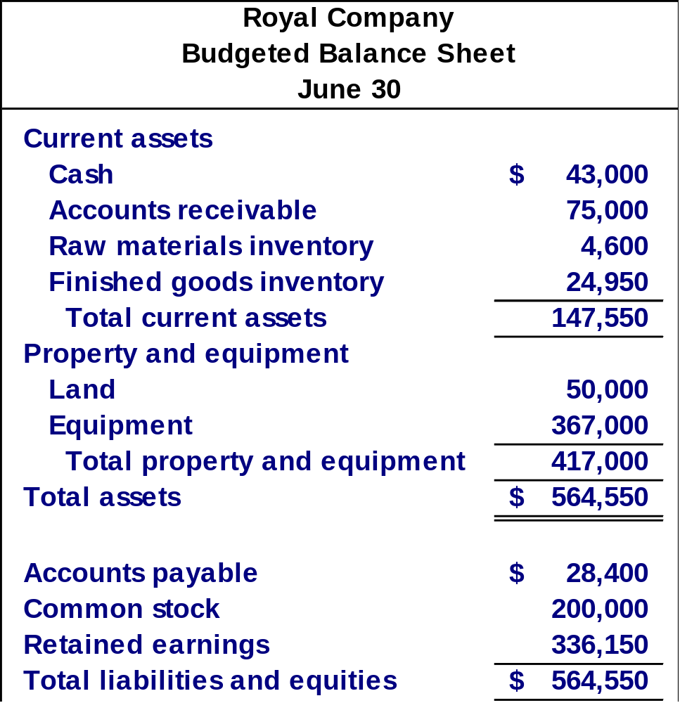
25% of June
sales of
$300,000
11,500 lbs.
at $0.40/lb.
5,000 units
at $4.99 each
50% of June
purchases
of $56,800
Notes:
You can see our cash balance of forty-three thousand dollars that comes directly from the cash budget. The other current assets and liabilities are explained by the boxes to the right. We provided you with supplemental information about land, equipment, and common stock.
On the next screen we will prepare a statement of retained earnings.

Slide 61
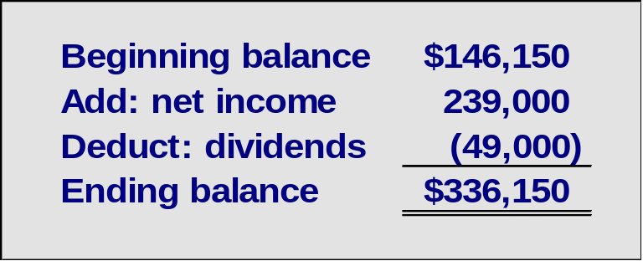
Notes:
We provided you with the beginning balance in retained earnings. We need to add the budgeted net income of two hundred thirty-nine thousand dollars and subtract the cash dividend paid in April of forty-nine thousand dollars to arrive at the ending balance in retained earnings.

