Slide 1
How Costs are Treated Under
Activity–Based Costing
ABC differs from traditional cost accounting in three ways.
Manufacturing
costs
Nonmanufacturing
costs
Traditional
product costing
ABC
product costing
❶ ABC assigns both types of costs to products.
Notes:
ABC differs from traditional cost accounting in three ways. The first is that nonmanufacturing as well as manufacturing costs may be assigned to products, but only on a cause-and-effect basis. For example, ABC systems can assign sales commissions, shipping costs, and warranty repair costs to specific products.

Slide 2
How Costs are Treated Under
Activity–Based Costing
ABC differs from traditional cost accounting in three ways.
Manufacturing
costs
Nonmanufacturing
costs
All
Most, but
not all
Some
Traditional
product costing
ABC
product costing
ABC does not assign all manufacturing costs to products.
Notes:
The second major difference between ABC and traditional cost accounting is that some manufacturing costs may be excluded from product costs. This is because ABC only assigns a cost to a product if decisions concerning that product will cause changes in the cost. ABC excludes two types of costs from product costs:
Organization-sustaining costs (which will be formally defined later); and
The costs of unused or idle capacity.

Slide 3
How Costs are Treated Under
Activity–Based Costing
ABC differs from traditional cost accounting in three ways.
Activity–Based
Costing
Departmental
Overhead
Rates
Level of complexity
Plantwide
Overhead
Rate
Number of cost pools
ABC uses more cost pools.
Notes:
The third major difference between ABC and traditional cost accounting is that numerous overhead cost pools are used, each of which is allocated to products and other cost objects using its own unique measure of activity. ABC cost pools are created to correspond to the activities performed in an organization that cause the consumption of overhead resources. Therefore, the total number of ABC cost pools will definitely exceed one (as in the plantwide approach) and it is likely to exceed the number of departments within a company (as in the departmental approach), since more than one activity is often performed within each department.

Slide 4
How Costs are Treated Under
Activity–Based Costing
Activity
An event that causes the consumption of overhead resources.
Activity Cost Pool
A “cost bucket” in which costs related to a single activity measure are accumulated.
$
$
$
$
$
$
Notes:
An activity is any event that causes the consumption of overhead resources.
An activity cost pool is a “bucket” in which costs are accumulated that relate to a single activity measure in an ABC system.

Slide 5

How Costs are Treated Under
Activity–Based Costing
ABC defines
five levels of activity
that largely do not relate
to the volume of units
produced.
Traditional cost systems usually rely on volume
measures such as direct labor hours and/or machine
hours to allocate all overhead costs to products.
Notes:
Traditional cost systems rely exclusively on allocation bases that are driven by the volume of production. ABC defines five levels of activity that largely do not relate to the volume of units produced.

Slide 6
How Costs are Treated Under
Activity–Based Costing
Unit-Level
Activity
Batch-Level
Activity
Manufacturing
companies typically combine
their activities into five
classifications.
Product-Level
Activity
Customer-Level
Activity
Organization-
sustaining
Activity
Notes:
In an activity-based cost system, companies typically combine their activities into the following five classifications:
Unit-level activities are performed each time a unit is produced. For example, providing power to run processing equipment would be a unit-level activity.
Batch-level activities are performed each time a batch is handled or processed, regardless of how many units are in the batch. For example, setting up equipment and shipping customer orders are batch-level activities.
Product-level activities relate to specific products and must be carried out regardless of how many batches are run or units are produced or sold. For example, designing or advertising a product would be product-level activities.
Customer-level activities relate to specific customers and are not tied to any specific product. For example, sales calls and catalog mailings would be customer-level activities.
Organization-sustaining activities are carried out regardless of which customers are served, which products are produced, how many batches are run, or how many units are made. For example, heating a factory and cleaning executive offices are organization-sustaining activities.

Slide 7
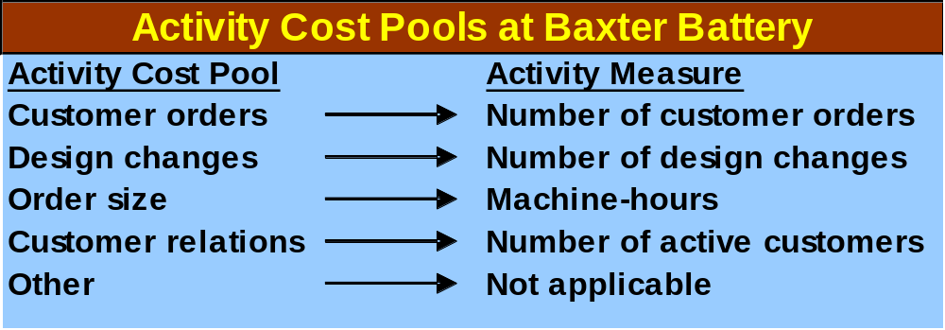


❶ Define Activities, Activity Cost
Pools, and Activity Measures
At Baxter Battery, the ABC team selected the following
activity cost pools and activity measures:
Notes:
The first step in implementing ABC is to define activities, activity cost pools, and activity measures. The activities are often identified and defined by interviewing the employees that work in the respective overhead departments. The lengthy list of activities that emerges from this process is usually reduced to a handful by combining similar activities.
Baxter Battery selected the following five activity cost pools and corresponding activity measures:
Activity Cost Pool Activity Measure
Customer orders Number of customer orders
Design changes Number of design changes
Order size Machine-hours
Customer relations Number of active customers
Other Not applicable

Slide 8
2
Assign costs to cost pools using a first-stage allocation.
Notes:
Learning objective number 2 is to assign costs to cost pools using a first-stage allocation.

Slide 9
Learning Objective 3
Compute activity
rates for cost pools.
Notes:
Learning objective number 3 is to compute activity rates for cost pools.

Slide 10
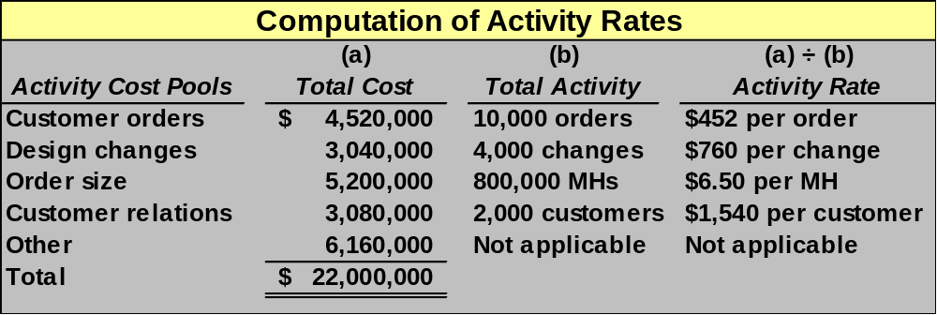
❸ Calculate Activity Rates
Notes:
The activity rate for each cost pool is computed by dividing the total cost for an activity cost pool by the total activity for that pool. For example, the customer orders activity rate is $452 per order. Importantly, this is an average figure.
Notice, the “other” cost pool does not have an activity rate. This is because these organization-sustaining costs will not be assigned to products or customers.

Slide 11
Learning Objective 4
Assign costs to a cost object using a second-stage allocation.
Notes:
Learning objective number 4 is to assign costs to a cost object using a second-stage allocation.

Slide 12
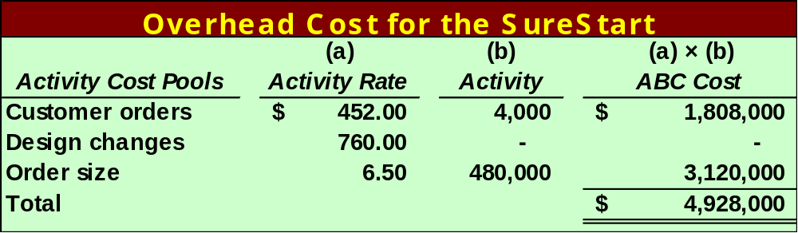
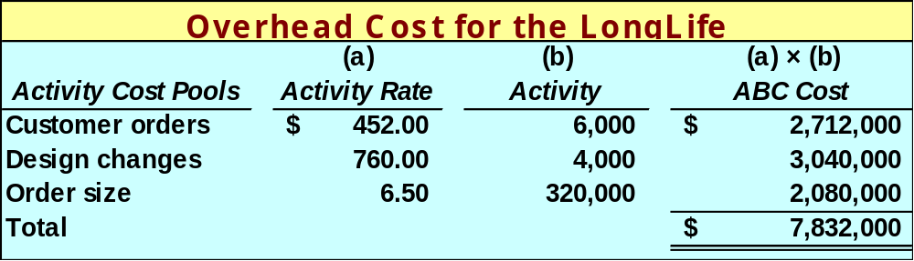
❹ Assigning Overhead to Products
Notes:
The overhead cost assignments to SureStarts and LongLifes are as shown. Notice that the total overhead costs assigned to SureStarts and LongLifes are $4,928,000 and $7,832,000, respectively, for a total of $12,760,000 assigned to the two products.
The total overhead costs assigned to products ($12,760,000) plus the total overhead costs not assigned to products ($9,240,000) equal the total overhead cost of $22,000,000 from earlier slides. The overhead not assigned to products consists of customer relations ($3,080,000) and other ($6,160,000).

Slide 13
Learning Objective 5
Use activity-based costing to compute product and customer margins.
Notes:
Learning objective number 5 is to use activity-based costing to compute product and customer margins.

Slide 14
Activity-Based Costing and External Reporting
Most companies do not use ABC
for external reporting because . . .
External reports are less detailed than internal reports.
It may be difficult to make changes to the company’s accounting system.
ABC does not conform to GAAP.
Auditors may be suspect of the subjective allocation process based on interviews with employees.
Notes:
There are four reasons why most companies do not use ABC for external reporting purposes. First, external reports are less detailed than internal reports in the sense that individual product costs are not reported. External reports only disclose cost of goods sold and ending inventory. Therefore, if some products are undercosted and others are overcosted, the errors tend to cancel each other out when the product costs are added together. Next, it is often very difficult to change a company’s accounting system because it is deeply embedded within complex computer programs that have evolved over many years.
Third, an ABC system, such as the one described in the chapter, does not conform to generally accepted accounting principles (GAAP). It excluded some organization-sustaining manufacturing costs, some unused capacity costs, and it included some nonmanufacturing costs in its product cost calculations. These cost system design attributes do not comply with GAAP. Finally, auditors are likely to be uncomfortable with cost allocations that are based upon interviews with the company’s personnel. This type of subjective data can be easily manipulated by management.

Slide 15

ABC Limitations
Substantial resources
required to implement
and maintain.
Resistance to
unfamiliar numbers
and reports.
Desire to fully
allocate all costs
to products.
Potential
misinterpretation of
unfamiliar numbers.
Does not conform to
GAAP. Two costing
systems may be needed.
Notes:
There are five limitations of activity-based costing. First, implementing an ABC system requires substantial resources. The benefits of increased cost accuracy may not outweigh the implementation costs. Next, ABC systems produce numbers, such as product margins, that are at odds with the numbers produced by traditional cost systems. Managers are not accustomed to managing their operations using these numbers; hence, ABC inevitably faces resistance. This underscores the importance of having top management support for, and cross-functional involvement with, the ABC implementation. Also, in practice, most managers insist on fully allocating all costs to products. The ABC system described in the main portion of this chapter does not conform to this preference. The next limitation is that ABC systems do not automatically identify the relevant costs for particular decisions; therefore, ABC data can be easily misinterpreted and must be used with care when making decisions. Costs assigned to products, customers, and other cost objects are only potentially relevant. Finally, most organizations use ABC as a supplement to, rather a replacement for, their existing cost system. Maintaining two cost systems is costlier than maintaining just one system and it may cause confusion about which set of numbers is to be relied on.

